Slide 1

Delaware National Guard
Social Media Training
Social media and the
Uniform Code of Military Justice

Slide 2

Social Media Roundup
Agenda
This Social Media Training examines punitive articles of the Uniform Code of Military Justice that can potentially be applied to individual social media use.
Introduction
Leadership responsibilities
Article 88 – Contempt toward officials
Article 89 – Disrespect toward superior commissioned officer
Article 91 – Insubordinate conduct toward warrant officer, noncommissioned officer, or petty officer
Article 133 – Conduct unbecoming an officer and a gentleman
Article 134 – General Article
Notes:
Social media can be a great tool for service members to stay in touch with family and friends. Between Facebook, Twitter, Instagram, and many others, there are many social media outlets available for Soldiers. However, Soldiers need to understand that they can be held accountable for any inappropriate activity in the virtual world just as they can be in the real world. This training discusses the articles of the UCMJ that can apply to social media activity, and provides some recent examples of service members engaging in questionable behavior.

Slide 3
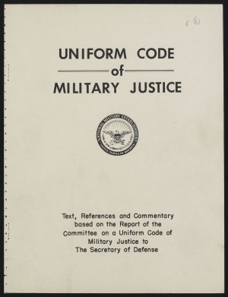
Introduction
Social Media Roundup
  Soldiers using social media must abide by the Uniform Code of Military Justice at all times. Commenting, posting, or linking to material that violates the UCMJ or basic rules of Soldier conduct is prohibited.
  Social media provides Soldiers the opportunity to talk about their interests and keep in touch with friends and family. However, Soldiers are subject to the Uniform Code of Military Justice even when off duty, so appropriate social media conduct is expected of all Soldiers. Talking negatively about supervisors or releasing sensitive information for example, is punishable under the UCMJ.
Notes:
Service members may be under the impression that their social media activity is “private” or “personal” and thus separate from their military service. This couldn’t be further from the truth. Just as a Soldier would be in trouble for disrespecting their LPO, LCPO, or Division Officer in person, those same rules apply to social media use. Soldiers simply must understand that they can be held accountable for violating policies, regulations and instructions in social media just as in person.

Slide 4
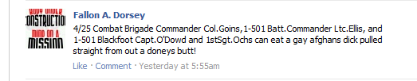
Leadership responsibilities
Social Media Roundup
  Determining how to punish or reprimand Soldiers for social media misuse is ultimately up to command leadership.
  The UCMJ should be used as a guide in determining the appropriate level of punishment, but it should not be the only document referenced. Every situation is different, so the UCMJ should be one of many resources used when evaluating the how social media misuse should be handled.
  It is also advised that leaders get JAG officers involved early in the disciplinary process to make sure all legal aspects of social media misuse are handled appropriately.
Above is an example of a public Facebook post from a Soldier directly criticizing his leadership by name.
Notes:
It’s up to each individual chain of command as to how social media infractions can/should be handled, just as with any other disciplinary action. This training is designed to increase Soldier awareness as to how the UCMJ and other Navy policies and regulations impact their social media use. This training is NOT meant to direct leadership on how social media infractions should be handled. Always consult with your command legal personnel in determining the best course of action.

Slide 5
Article 88 – Contempt toward officials
Social Media Roundup
  Article 88 deals specifically with contemptuous language directed at U.S. officials. Contemptuous Facebook posts or Tweets can fall under this article.
ART. 88
Any commissioned officer who uses contemptuous words against the President, the Vice President, Congress, the Secretary of Defense, the Secretary of a military department, the Secretary of Transportation, or the Governor or legislature of any State, Territory, Commonwealth, or possession in which he is on duty or present shall be punished as a court-martial may direct.
Notes:
Soldiers who use social media to complain about or insult the President, Vice President, Congress, Secretary of Defense, Secretary of Defense, or elected state officials are in fact violating Article 88 of the UCMJ. This article is directed specifically toward commissioned officers, but there are other articles that could cover the same behavior from enlisted personnel.

Slide 6
Article 89 – Disrespect toward superior commissioned officer
Social Media Roundup
  Article 89 is one of the more applicable articles of the UCMJ in reference to social media use.
  Some Soldiers believe that once they leave work, they are free to say whatever they please about their leadership. Some take to Facebook and other social media platforms to “vent.”
  While social media use is not specifically referenced in the UCMJ, posting disrespectful comments about leadership on your Facebook profile falls under the category of disrespect toward superior commissioned officer and leaves you subject to punishment under the UCMJ.
ART. 89
Any person subject to this chapter who behaves with disrespect toward his superior commissioned officer shall be punished as a court-martial may direct.
Notes:
Every Soldier complains about a bad day, and it is normal for them to voice frustrations. However, if Soldiers use Twitter or Facebook to complain about their division officer, department head or commanding officer, they could be charged with Article 89.

Slide 7
Article 91 – Insubordinate conduct toward warrant officer, noncommissioned officer, or petty officer
Social Media Roundup
  The primary focus of Article 91 is the third point. The wording of the third bullet is similar to Article 89, but it includes warrant officers and noncommissioned officers.
ART. 91
Any warrant officer or enlisted member who--
(1) strikes or assaults a warrant officer, noncommissioned officer, or petty officer, while that officer is in the execution of his office;
(2) willfully disobeys the lawful order of a warrant officer, noncommissioned officer, or petty officer; or
(3) treats with contempt or is disrespectful in language or deportment toward a warrant officer, noncommissioned officer, or petty officer while that officer is in the execution of his office;
shall be punished as a court-martial may direct.
Notes:
Like Article 89, if a Soldier complains about or insults their workcenter supervisor, LPO, or LCPO, they could be charged with violating article 91. Specifically, it’s (3) that refers to social media activity.

Slide 8
Article 133 – Conduct unbecoming an officer and a gentleman
Social Media Roundup
  Article 133 is a catch-all article. Several instances of inappropriate social media use can fall under this article.
  Posting obscene photos, linking to inappropriate material or conducting yourself on a social media platform in a manner that is unprofessional or generally offensive can lead to punishment under the UCMJ.
ART. 133
Any commissioned officer, cadet, or midshipman who is convicted of conduct unbecoming an officer and a gentleman shall be punished as a court-martial may direct.
Notes:
Article 133 refers to behavior from a commissioned officer or midshipman that is prejudicial to good order and discipline or brings discredit upon the armed forces.

Slide 9
Article 134 – General Article
Social Media Roundup
  Article 134 includes an extensive list of additional offenses that can lead to punishment under the UCMJ. Article 134-12 covers disloyal statements, and Soldier posts and Tweets can potentially fall under this article.
ART. 134 – General Article
Though not specifically mentioned in this chapter, all disorders and neglects to the prejudice of good order and discipline in the armed forces, all conduct of a nature to bring discredit upon the armed forces, and crimes and offenses not capital, of which persons subject to this chapter may be guilty, shall be taken cognizance of by a general, special or summary court-martial, according to the nature and degree of the offense, and shall be punished at the discretion of that court.
ART. 134-12
(1) That the accused made a certain statement;
(2) That the statement was communicated to another person;
(3) That the statement was disloyal to the United States;
(4) That the statement was made with the intent to promote disloyalty or disaffection toward the United States by any member of the armed forces or to interfere with or impair the loyalty to the United States or good order and discipline of any member of the armed forces; and
(5) That, under the circumstances, the conduct of the accused was to the prejudice of good order and discipline in the armed forces or was of a nature to bring discredit upon the armed forces.
Notes:
Article 134 is the catch-all for enlisted behavior. The key is that the behavior is prejudicial to good order and discipline or is of a nature to bring discredit to the armed forces.

Slide 10
Article 92 – Failure to obey order or regulation
Social Media Roundup
  Article 92 could be applicable if Soldiers post evidence of underage drinking, fraternization, adultery, frequenting off-limits establishments, etc., on social media.
ART. 92
Any person subject to this chapter who--
(1) violates or fails to obey any lawful general order or regulation;
(2) having knowledge of any other lawful order issued by any member of the armed forces, which it is his duty to obey, fails to obey the order; or
(3) is derelict in the performance of his duties;
shall be punished as a court-martial may direct.
Notes:
If Soldiers post photos of themselves frequenting an establishment that has been identified as off-limits, or posts statuses or photos of themselves being derelict in their duty, Article 92 could apply.

Slide 11
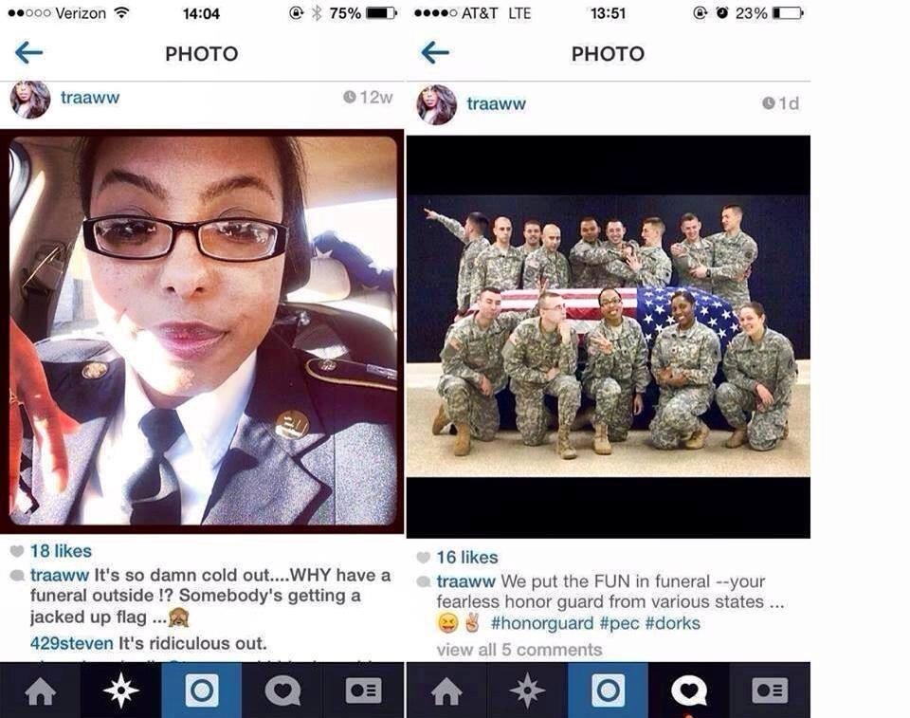
Example
Social Media Roundup
Notes:
This member of the Wisconsin National Guard funeral detail posted inappropriate photos and insensitive comments to her personal Instagram account.

Slide 12
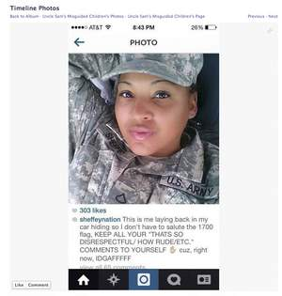
Example
Social Media Roundup
Notes:
This soldier posted this photo of herself, with the caption stating that she was laying back in her car specifically to avoid evening colors on her post.

Slide 13
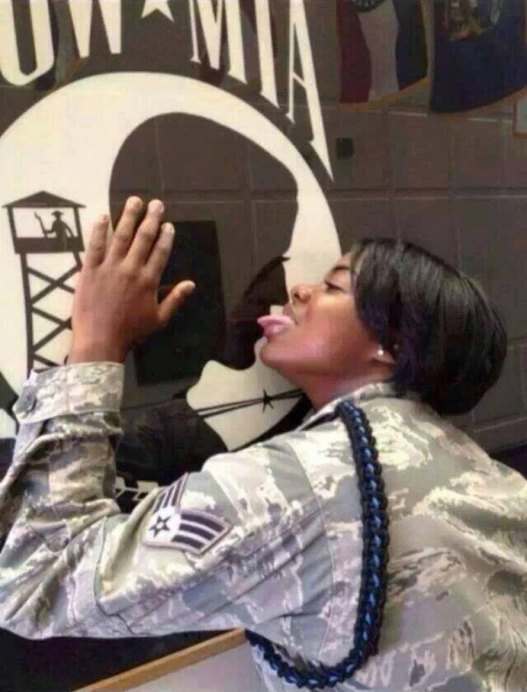
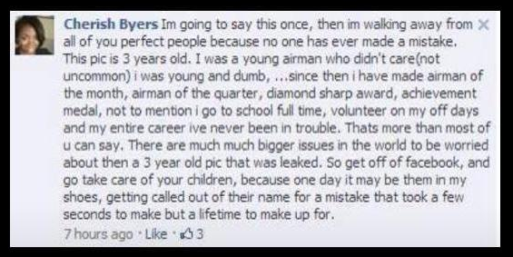
Example
Social Media Roundup
Notes:
This airman’s photo on her personal Facebook account was more than three years old when someone found it and shared it. Within a day, the photo went viral.

Slide 14
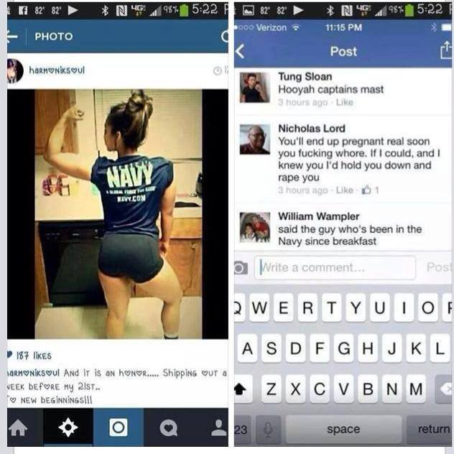
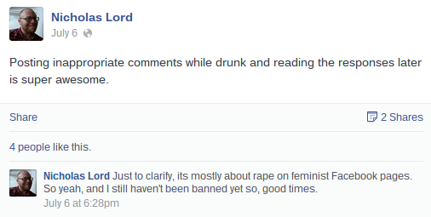
Example
Social Media Roundup
Notes:
Petty Officer 2nd Class Lord, assigned to USS NIMITZ, was taken to captain’s mast. Because NJP is an administrative action, the specific details of the charges he faced and the punishment he was awarded were not officially made public.

Slide 15
DoD Directive 1344.10, “Political Activities by Members of the Armed Forces on Active Duty”
Social Media Roundup
  …Members on active duty should not engage in partisan political activity, and members not on active duty should avoid inferences that their political activities imply or appear to imply official sponsorship, approval, or endorsement…
Do:
Register and vote
Sign petitions
Make donations
Join partisan/nonpartisan groups and attend meetings as a citizen
Express personal views as a citizen, separate from your military service
Follow political parties, candidates, campaigns, groups or causes on social media
Do Not:
Wear your uniform to political events
Campaign for or on behalf of political campaigns, candidates or causes
Make public commentary for political campaigns, candidates or causes
Post to, comment on, link to, recommend, or forward from the social media accounts of political parties, candidates, campaigns, or causes
Notes:
In addition to the UCMJ articles, there are also plenty of other policies and regulations that govern our behavior as Soldiers. One sensitive area of social media relates to politics. Soldiers can and should care about the electoral process, as it is their only chance to have input into the most senior leadership of their country. However, they also need to be familiar with DoD Directive 1344.10, “Political Activities by Members of the Armed Forces on Active Duty.” This slide is just the briefest overview of the guidance within 1344.10. Soldiers who frequently use social media to discuss politics should take the time to read the directive in its entirety. These are just a few examples… be advised, the “DO NOT” list is much longer.

Slide 16
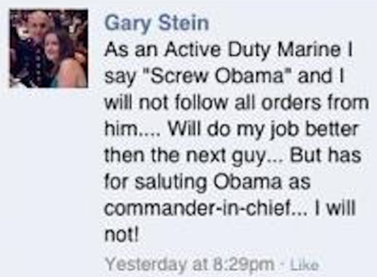
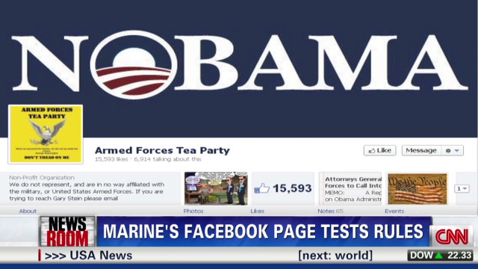
Example
Social Media Roundup
Notes:
Marine Sgt. Gary Stein received an Other Than Honorable discharge from the Marine Corps in April 2012. Stein believed that this disclaimer about the page shielded him from legal consequences, but that was not the case. He named the group the “Armed Forces Tea Party,” implying a direct affiliation. He clearly and frequently identified himself as an active duty Marine, both in words and in photos of himself in uniform, and he stated blatantly that he would not follow the orders of the commander-in-chief, nor would he render the salute required. Every Soldier who enlists repeats the oath stating that they will obey the orders of the President of the United States and the orders of the officers appointed over them, according to regulations and the Uniform Code of Military Justice. That oath is not conditional.

Slide 17
Social Media Roundup
Things to consider
In the Army 24/7/365, even on Facebook/Twitter/Instagram
  UCMJ articles apply in the real world AND the virtual world
Photos and posts of illegal activity is evidence
  Whether it’s civilian laws or UCMJ, posts or photos about underage drinking, tags that show you to be out-of-bounds or at an off-limits establishment, infidelity, fraternization, etc.
OPSEC
  Photos and information from work that should be screened for security or propriety can get you in trouble.
Notes:
The bottom line is that a Soldier’s social media activity falls under the exact same regulations and policies as the rest of the Soldier’s behavior. Personal privacy doesn’t apply. Social media is great for deployed service members, but must be used responsibly. Personal responsibility is the key. If you post it, you’re responsible for it, and may have to answer for it.

Slide 18
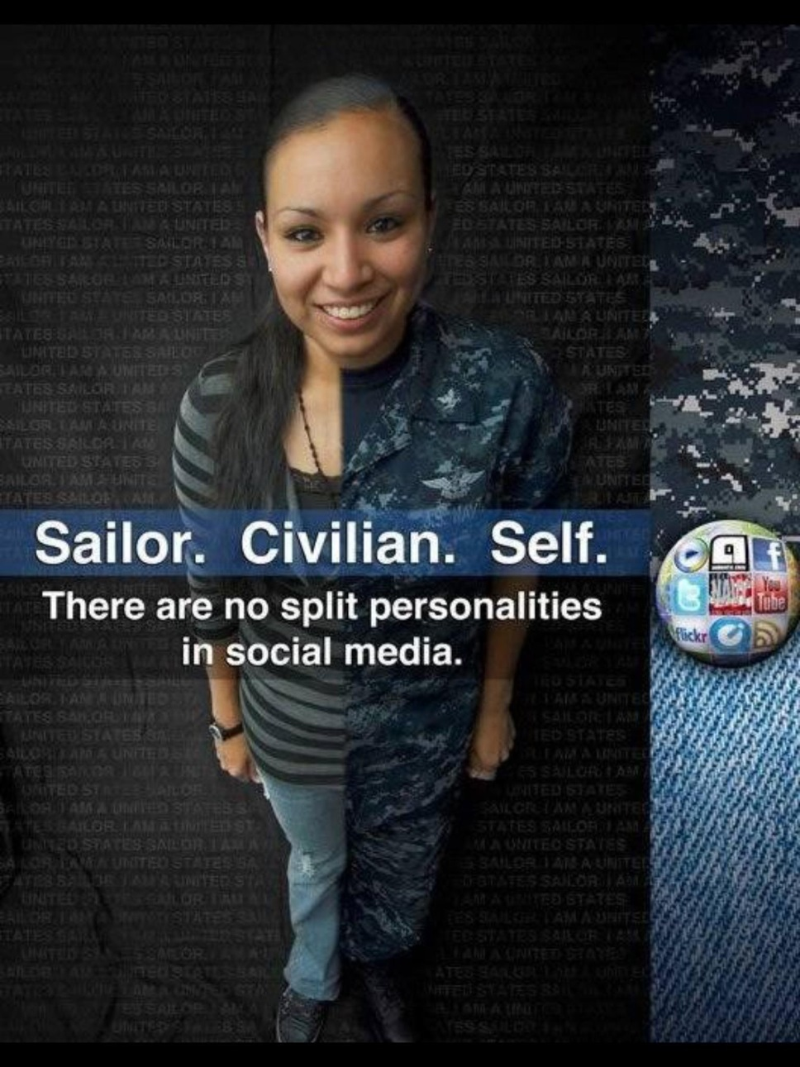
Social Media Roundup

Slide 19

Social Media Roundup

